Slide 1

This is
non-sexual consensual touch
event
You can leave at any time
Rules
1

Slide 2
This is
non-sexual consensual touch
event
You don't have to cuddle anyone at a Cuddle Party, ever
Rules
2

Slide 3
This is
non-sexual consensual touch
event
Pajamas stay on the whole time
Rules
3

Slide 4
This is
non-sexual consensual touch
event
you must ask permission
and receive a verbal ‘Yes’ before
you touch anyone
Rules
4

Slide 5
This is
non-sexual consensual touch
event
If you are a ‘Yes’ say ’Yes’
If you are a ‘No’ say ’No’
If you are a ‘Maybe’ say ’No’
Rules
5

Slide 6


This is
non-sexual consensual touch
event
At anytime you feel uncomfortable the facilitators are here for you
come talk to us privately
Rules
Trinity
Llewellyn
6

Slide 7
This is
non-sexual consensual touch
event
Crying and giggling are both welcomed and encouraged
Rules
7

Slide 8
This is
non-sexual consensual touch
event
Please be respectful of other people's privacy
when sharing with the outside world keep people anonymous
Rules
8

Slide 9
This is
non-sexual consensual touch
event
Always say ‘thank you’ and practice good Cuddle Manners
Rules
9

Slide 10
This is
non-sexual consensual touch
event
After a “no”
wait for
them to ask
you next.
Rules
9

Slide 11
Remember to
Thank each other
for taking care
of themselves
when you get a NO
Rules
10

Slide 12
This is
non-sexual consensual touch
event
For those in a relationship:
Have you discussed your relationship boundaries with your partner?
If not, do so now.
Rules
& honor your relationships
11

Slide 13
The
Buddy Bench
2

Slide 14
The
Solo Salon
2

Slide 15
This is
non-sexual consensual touch
event
You don't have to cuddle anyone at a Cuddle Party, ever
Rules
2

Slide 16
This is
non-sexual consensual touch
event
Always say ‘thank you’ and practice good Cuddle Manners
Rules
9

Slide 17
This is
non-sexual consensual touch
event
Pajamas stay on the whole time
Rules
3

Slide 18
This is
non-sexual consensual touch
event
After a “no”
wait for
them to ask
you next.
Rules
9

Slide 19
This is
non-sexual consensual touch
event
Please be respectful of other people's privacy
when sharing with the outside world keep people anonymous
Rules
8

Slide 20
It’s ok to say
“No”
No makes your Yes mean something
find your yeses

Slide 21
It’s ok to say
“please stop asking”
find your yeses

Slide 22
What are your
Cuddle Boundaries?
find your yeses

Slide 23
It’s ok to
ask for what you want
find your yeses

Slide 24
Warning:
touch can release strong emotions
Honor your Boundaries
You are under no OBLIGATION to caretake for others
find your yeses

Slide 25
What would like to
Get from this event?
find your yeses

Slide 26
This is a great place to practice
Hearing
& Accepting
a NO
find your yeses

Slide 27
What would make today
Amazing
for you?
find your yeses

Slide 28
What kind of
touches do
you NOT like?
find your yeses

Slide 29
What kind of
touches do you like?
find your yeses

Slide 30
This is a chance to
practice your boundaries
find your yeses

Slide 31
It’s ok to
Change your mind
at any time
find your yeses

Slide 32
Wheel of Consent By Betty Martin
I AM DOING
GIVING and RECIVING
TAKING
“Will you …?”
GIVING
vs.
FOR THEM
FOR ME
TAKING and ALLOWING
ALLOWING
RECIVING
“May I … ?”
THEY ARE DOING
find your yeses

Slide 33
Types of touches:
rubbing
caressing
stroking
massaging
hugging
patting
resting
holding stroking
… and more
Pressure:
soft(er)
hard(er)
Cuddle Options

Slide 34

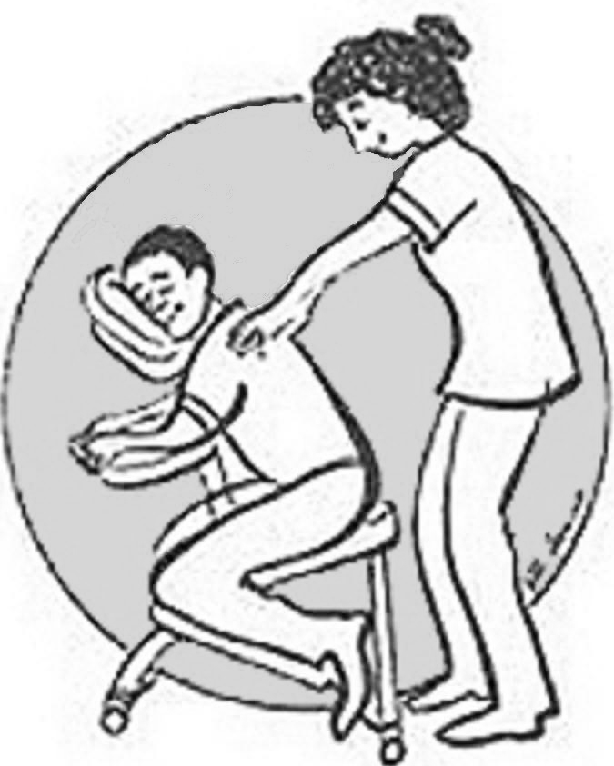

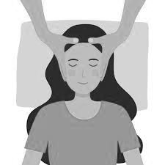
Massage
Foot
Back
Hand
Head
Cuddle Options

Slide 35
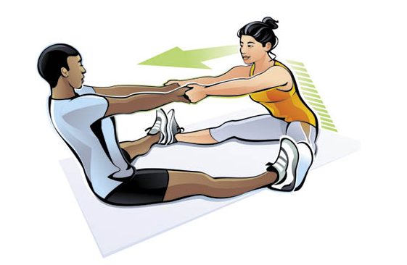
Partner Stretching
Cuddle Options

Slide 36

Talk
(Active listening is a form of touch)
Cuddle Options

Slide 37

Yin-Yang
Cuddle Options

Slide 38
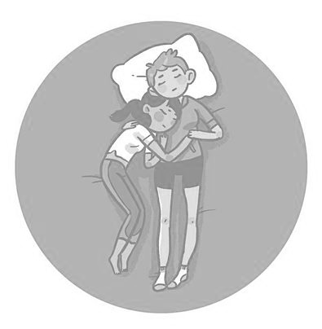
Half Spoon
Cuddle Options

Slide 39
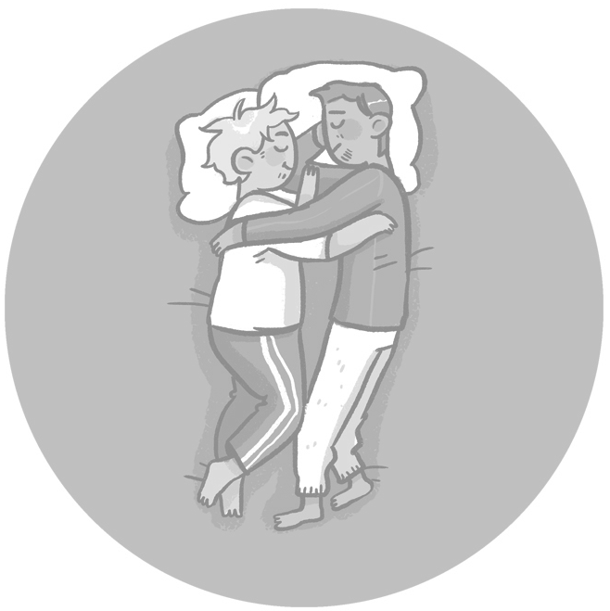
Face to Face
Cuddle Options

Slide 40
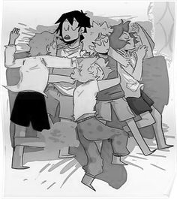
Cuddle Puddle
Cuddle Options

Slide 41
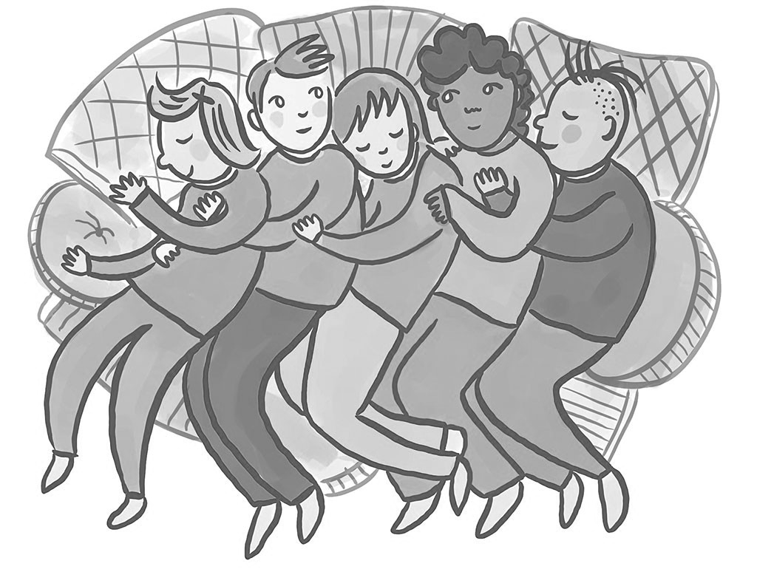
Spoon Drawer
Cuddle Options

Slide 42
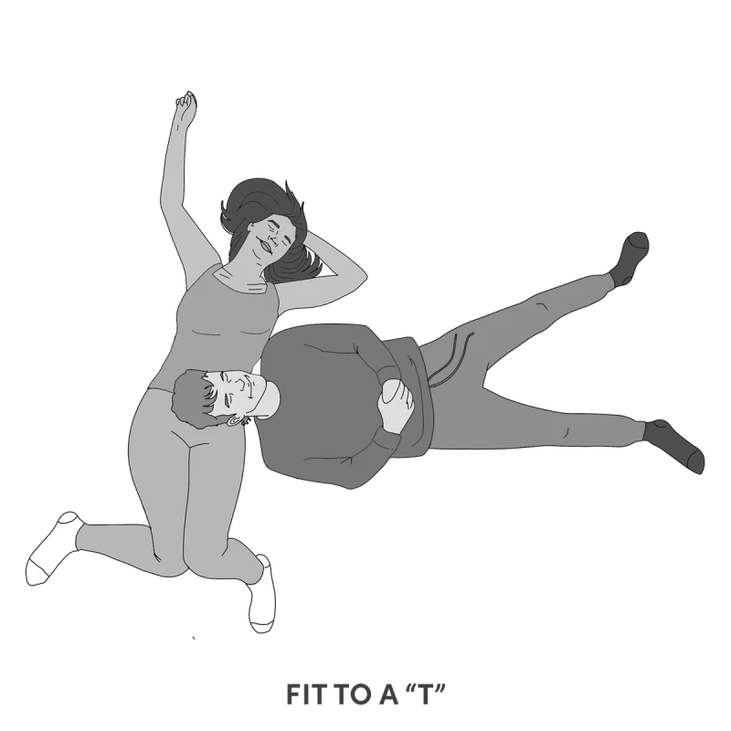
Head in Lap
(laying down)
Cuddle Options

Slide 43
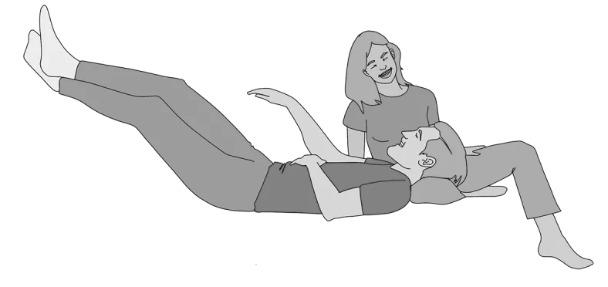
Head in Lap
(sitting)
Cuddle Options

Slide 44
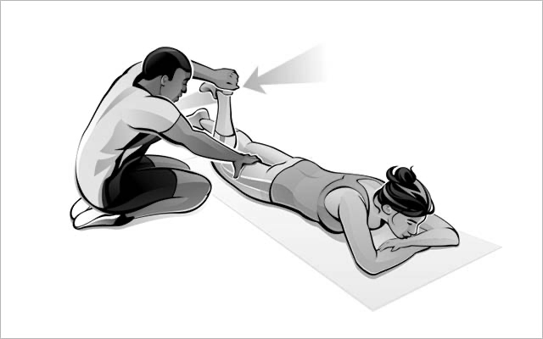
Joint Movement
(for Range of Motion)
Cuddle Options

Slide 45
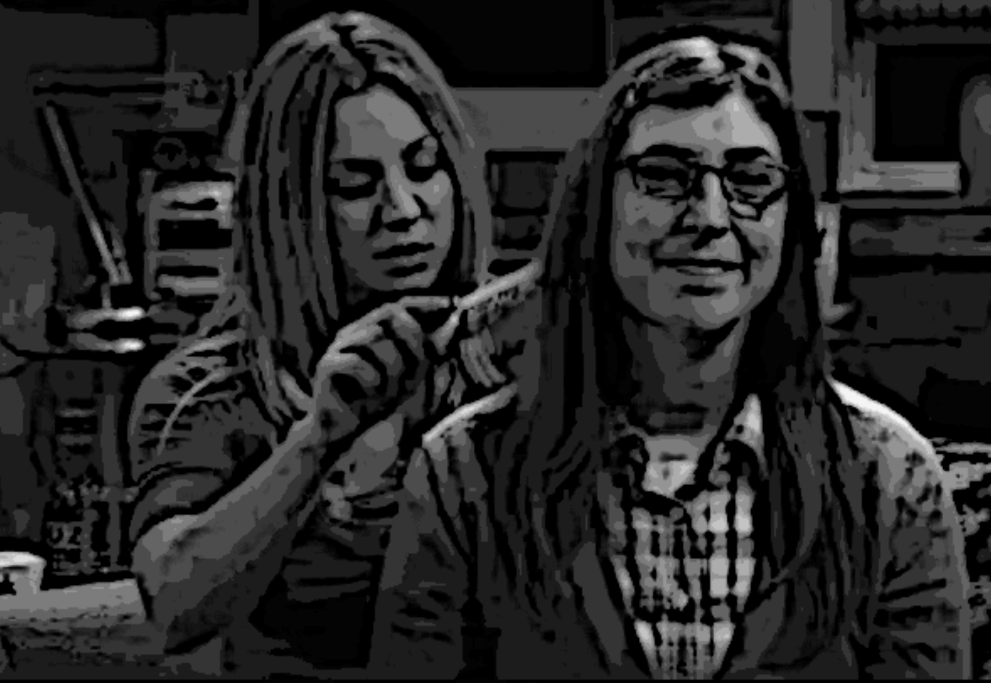
Brush or play with someone’s hair
Cuddle Options

Slide 46
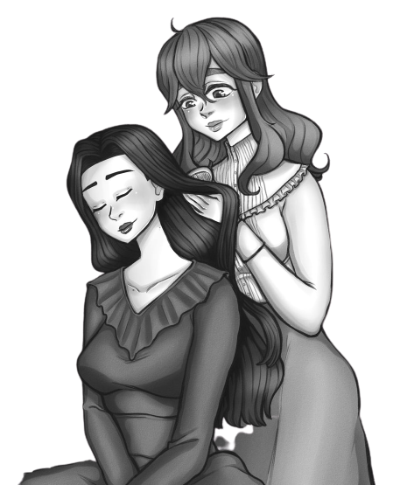
Brush or play with someone’s hair
Cuddle Options

Slide 47
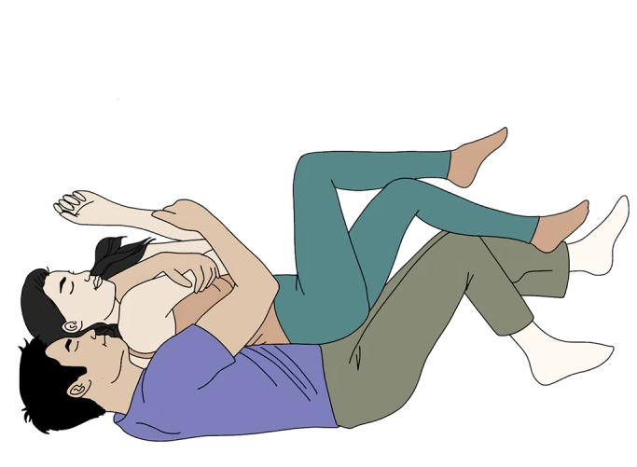
Spooning
Cuddle Options

Slide 48

Back-to-Back
Cuddle Options

Slide 49

Front-to-Back
Cuddle Options

Slide 50
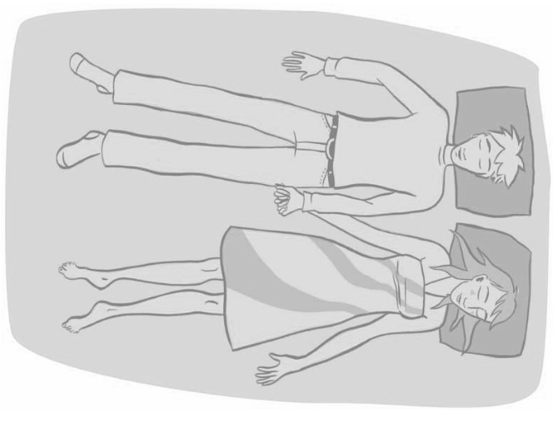
Side-to-Side
Cuddle Options

Slide 51
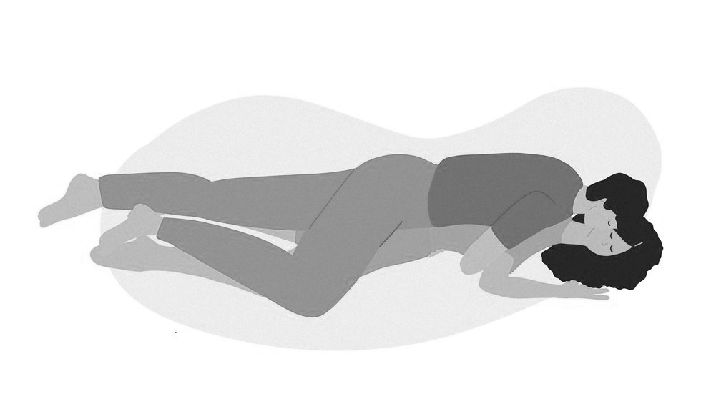
The Squish
Cuddle Options

Slide 52
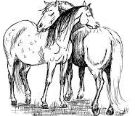
Back Scratches
Cuddle Options

Slide 53
Welcome

Slide 54
CLOSED
No Entry

Slide 55

Anderson Ave SE
Carlisle Blvd Se
No entry after 3:00pm

Slide 56
Anderson Ave SE
Carlisle Blvd Se
No entry after 2:10pm

Slide 57
CLOSED
No Entry
No entry after 3:00pm

Slide 58
☺

Slide 59
☹

Slide 60
Next Time…

Slide 61
Anderson Ave SE
Carlisle Blvd Se

